Slide 1
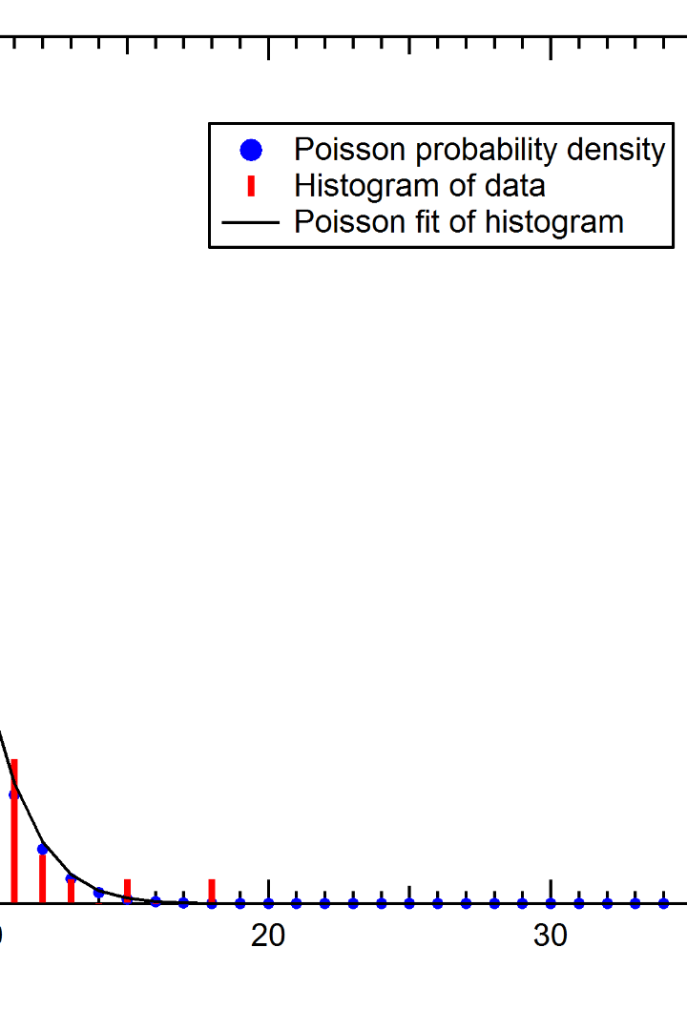

Understanding the Poisson Distribution
The Poisson distribution, named after Siméon Denis Poisson, is a probability distribution that describes the number of events occurring within a fixed interval of time or space.

Slide 2
Applications of the Poisson Distribution
Queueing Theory
Insurance Claims
The Poisson distribution is used to model the arrival of customers in a queue or the flow of traffic in transportation systems.
Insurance companies use the Poisson distribution to estimate the number of claims they are likely to receive in a given period.
Telephone Calls
Radioactive Decay
The arrival of phone calls can be modeled using the Poisson distribution to analyze call center performance and staffing needs.
The Poisson distribution is also used to model the random and independent nature of radioactive decay events.

Slide 3
Characteristics of the Poisson Distribution
1
Event Independence
2
Fixed Interval
The occurrence of one event does not affect the likelihood of another event happening.
The number of events is counted within a specific time or space interval.
3
Constant Rate
4
Discrete Values
The average rate of event occurrence remains the same throughout the interval.
The Poisson distribution deals with whole numbers representing the count of events.

Slide 4

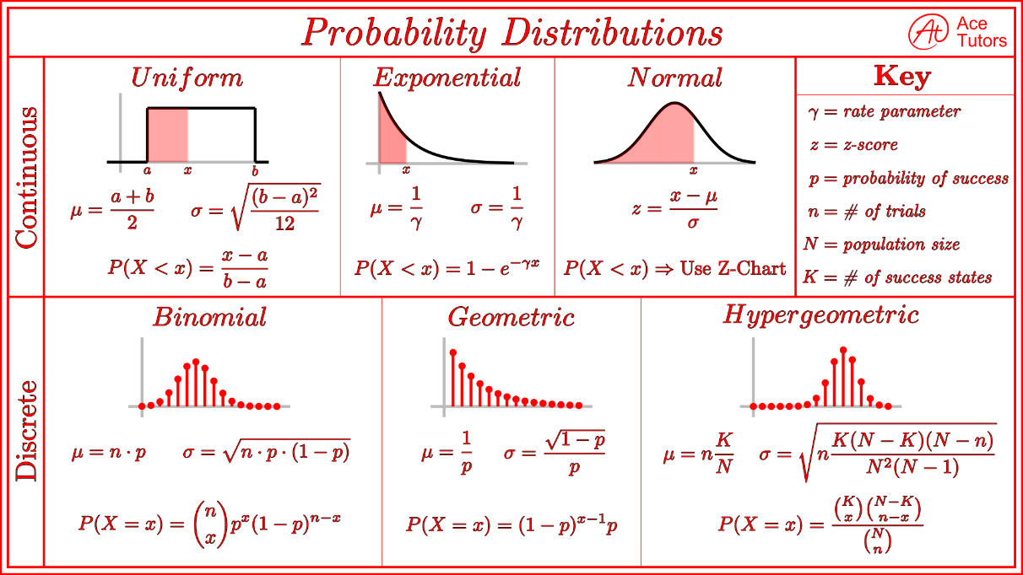
The Probability Mass Function
The probability mass function (PMF) of the Poisson distribution is given by:

Slide 5
Calculating Probabilities with the Poisson Distribution
Step 1: Define the Average Rate
Step 2: Define the Variable of Interest
Step 3: Apply the PMF Formula
Determine the average rate of event occurrence (λ) within the fixed interval.
Use the PMF formula to calculate the probability of the desired number of events occurring.
Identify the number of events (k) for which you want to calculate the probability.

Slide 6

Limitations of the Poisson Distribution
1
Assumptions
The Poisson distribution assumes that events occur independently and at a constant rate, which may not always be true in real-world scenarios.
Large Event Counts
2
The Poisson distribution becomes less accurate when the average rate of events is very high or the number of events being counted is large.
3
Time Considerations
The Poisson distribution may not be appropriate for intervals where events can only occur at specific times or when events are not evenly distributed.

Slide 7
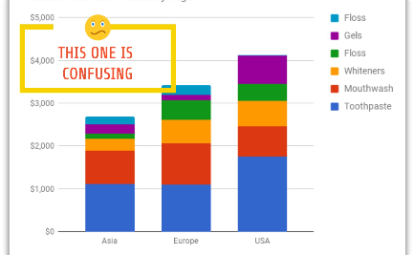
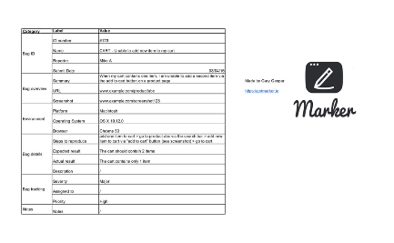

Example: Using the Poisson Distribution in Practice
Retail Sales Forecasting
Bug Report Analysis
Traffic Flow Modeling
A retail store can use the Poisson distribution to predict the number of sales that will occur during a specific time period, helping with inventory management and staffing.
A software development team can utilize the Poisson distribution to analyze the number of reported bugs per day and allocate resources accordingly.
Traffic engineers can employ the Poisson distribution to predict congestion levels on city streets based on historical data of vehicular arrivals.

Slide 8

THANK YOU
Hemanth sai teja
23071A6710
CSD-A

